Slide 1


Slide 2

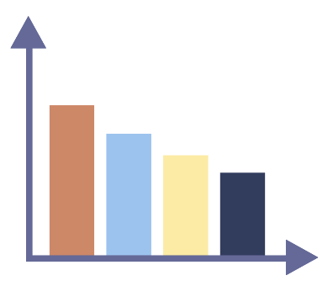

Graphs
Display numeric information in an illustrative way.

Slide 3
Graphs
Display numeric information in an illustrative way.
Allow users to interpret relationships and trends in data.

Slide 4
Graphs
Display numeric information in an illustrative way.
Allow users to interpret relationships and trends in data.
Can help reduce biases and inform decision making.

Slide 5
Objectives
Identify common graphs used for categorical data
Select the appropriate type of graph for data

Slide 8
Bar Graph
Useful when comparing exact datapoint across categories or groups

Slide 9
Bar Graph
Useful when comparing exact datapoint across categories or groups
Probability, proportion (%), average scores, frequency, etc.

Slide 10
Favorite Type of Weather
Weather | Number of Students
Sunny | 10
Rainy | 5
Windy | 1
Snowy | 7
Cloudy | 3
Hot | 1

Slide 11


Icon Array

Slide 12
Data from 1980’s
3 out of 10 significant tornadoes were preceded by tornado warnings
Source: NOAA (Hales Jr. 1989)

Slide 13


Data from 1980’s
3 out of 10 significant tornadoes were preceded by tornado warnings
Source: NOAA (Hales Jr. 1989)

Slide 14

Building a dam will reduce the risk of flood damage of ImagineCity by 14%!

Slide 15

Should they build a dam?

Slide 16

Baseline risk of flooding
Flooding occurs on 7 out of 100 days
Flooding occurs 6 out of 100 days
14% reduction of relative risk
Risk of flooding with a dam

Slide 17
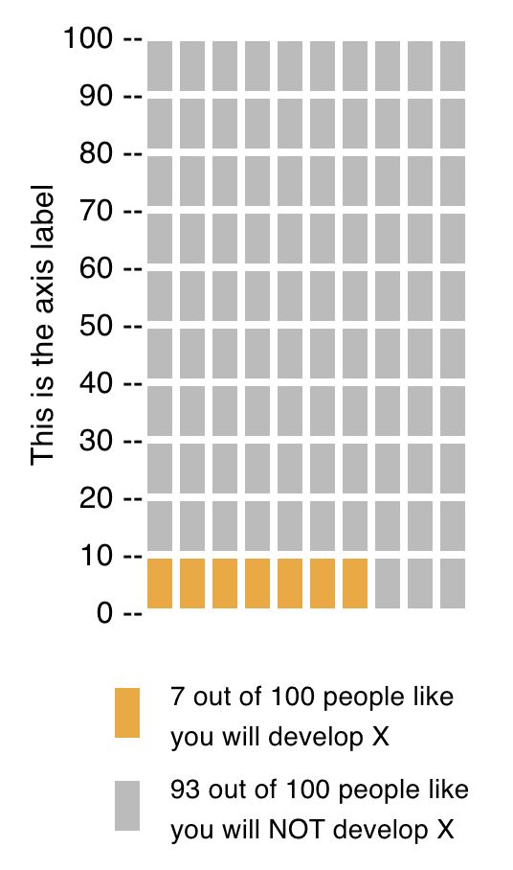

Baseline risk of flooding
Days on which flooding occurs
Days on which flooding does NOT occur

Slide 18
Baseline risk of flooding
On 7 out of 100 days, flooding occurs
On 93 out of 100 days flooding does NOT occur
Days on which flooding occurs
Days on which flooding does NOT occur

Slide 19
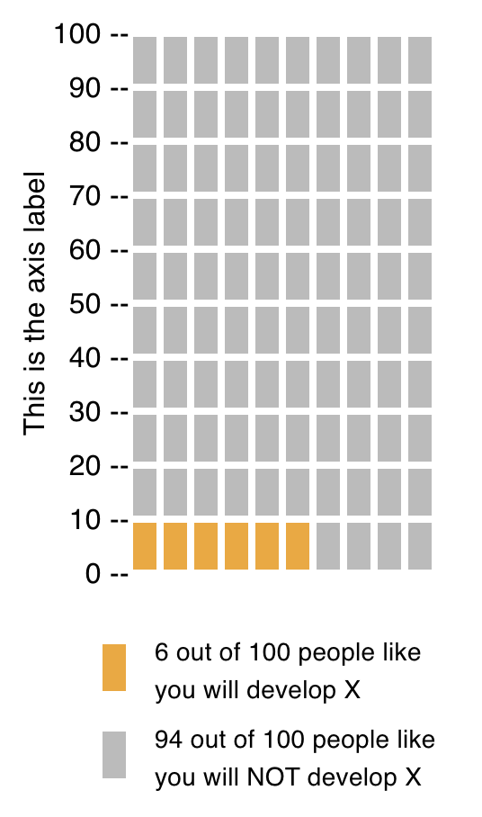
Baseline risk of flooding
Risk of flooding with a dam
Days on which flooding occurs
Days on which flooding does NOT occur

Slide 20
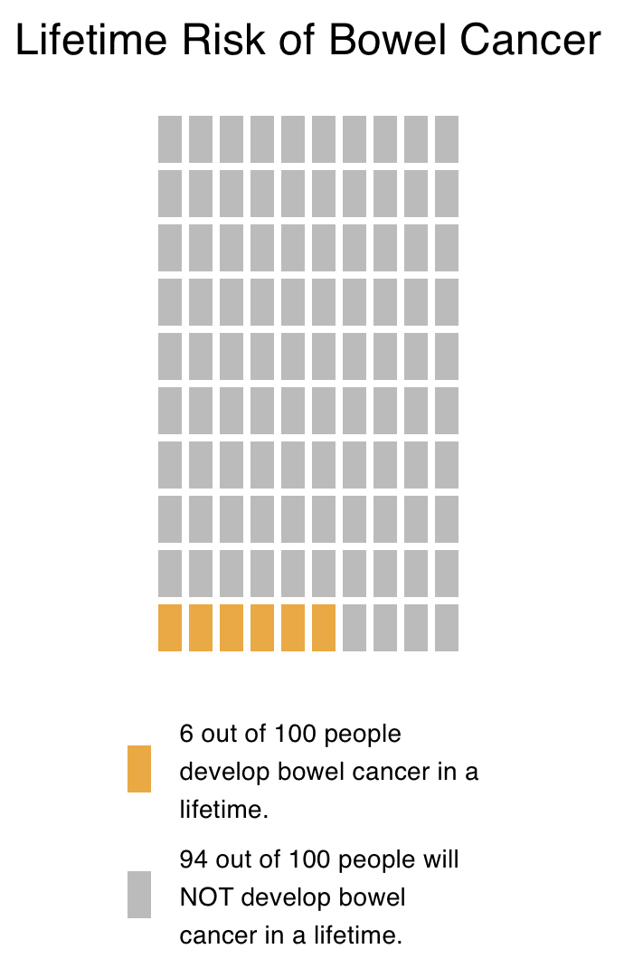
Baseline risk of flooding
Risk of flooding with a dam
Days on which flooding occurs
Days on which flooding does NOT occur

Slide 21
Icon Array
Visually depicts a set-subset relationship
  Set: the entire set of elements or people
  Subset: a specific group of interest, within the set

Slide 22
Icon Array
Visually depicts a set-subset relationship
  Set: the entire set of elements or people
  Subset: a specific group of interest, within the set

Slide 23
Icon Array
Risk of flooding with a dam
Set: the entire set of elements or people
Subset: a specific group of interest, within the set
Days on which flooding occurs
Days on which flooding does NOT occur

Slide 24
Icon Array
Risk of flooding with a dam
set
Set: the entire set of elements or people
→ total of 100 days
Subset: a specific group of interest, within the set
Days on which flooding occurs
Days on which flooding does NOT occur

Slide 25
Icon Array
Risk of flooding with a dam
Set: the entire set of elements or people
→ total of 100 days
Subset: a specific group of interest, within the set
→ 6 days with flooding
subset 1
Days on which flooding occurs
Days on which flooding does NOT occur

Slide 26
Icon Array
Risk of flooding with a dam
Set: the entire set of elements or people
→ total of 100 days
Subset: a specific group of interest, within the set
→ 6 days with flooding
→ 94 days without flooding
subset 2
Days on which flooding occurs
Days on which flooding does NOT occur

Slide 27
Icon Array
Icon arrays can be used to compare proportions of subsets in unequally sized sets.
Town X: Heavy snow on 15 out of 100 days
Town Y: Heavy snow on 8 out of 16 days

Slide 28
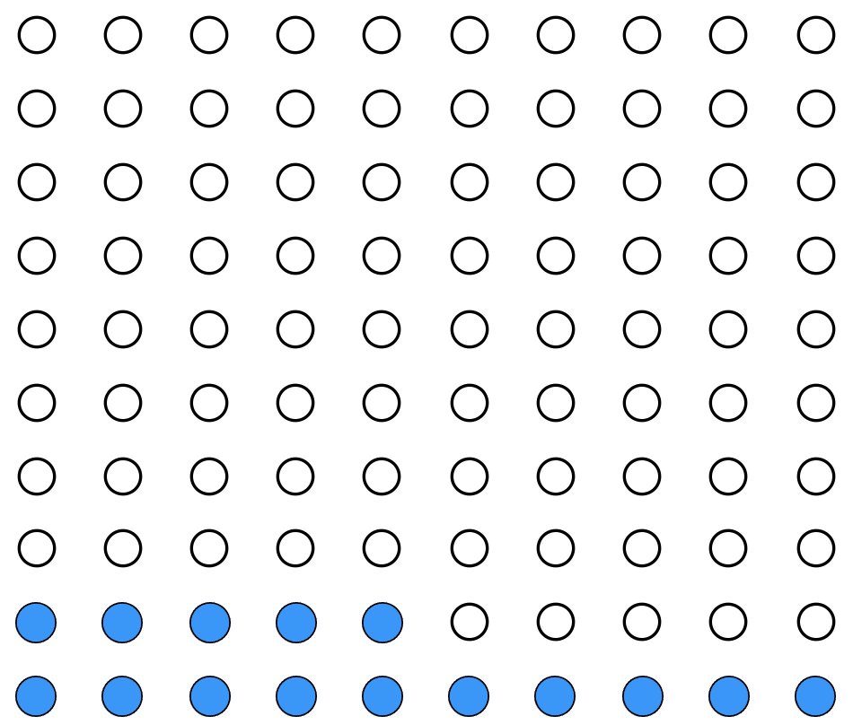

Icon Array
Town X: 15 out of 100 days
Town Y: 8 out of 16 days

Slide 29
A severe heatwave hit two buildings.
9 out of 100 people working in Building A got sick after the heatwave.
1 out of 10 people working in Building B got sick after the heatwave.

Slide 30
Visualize the data.
A severe heatwave hit two buildings.
9 out of 100 people working in Building A got sick after the heatwave.
1 out of 10 people working in Building B got sick after the heatwave.

Slide 31
Visualize the data.
A severe heatwave hit two buildings.
9 out of 100 people working in Building A got sick after the heatwave.
1 out of 10 people working in Building B got sick after the heatwave.

Slide 32
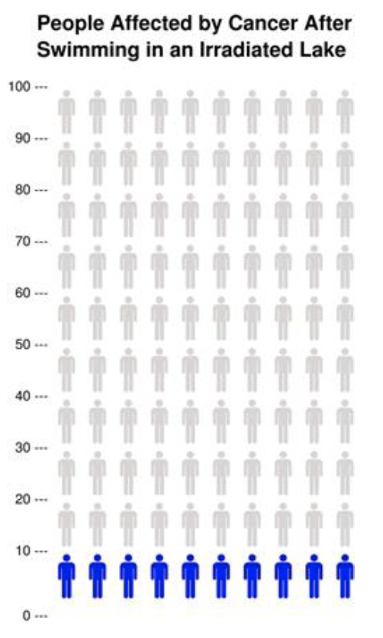


Visualize the data.
A severe heatwave hit two buildings.
9 out of 100 people working in Building A got sick after the heatwave.
1 out of 10 people working in Building B got sick after the heatwave.
People in Building A
People who got sick
People who did not get sick

Slide 33
Visualize the data.
A severe heatwave hit two buildings.
9 out of 100 people working in Building A got sick after the heatwave.
1 out of 10 people working in Building B got sick after the heatwave.
People in Building A
People in Building B
People who got sick
People who did not get sick

Slide 34
Which building had higher probability of people getting sick after a severe heatwave?
A severe heatwave hit two buildings.
9 out of 100 people working in Building A got sick after the heatwave.
1 out of 10 people working in Building B got sick after the heatwave.
People in Building A
People in Building B
People who got sick
People who did not get sick

Slide 35
Which building had higher probability of people getting sick after a severe heatwave?
A severe heatwave hit two buildings.
9 out of 100 people working in Building A got sick after the heatwave.
1 out of 10 people working in Building B got sick after the heatwave.
People in Building A
People in Building B
People who got sick
People who did not get sick

Slide 36
Visualize the data.
A survey asked people, “Have you experienced extreme weather conditions (e.g., hurricane, tornado, flood, or extreme heatwave) in your area in the last year?”
# of response | Areas of Residence
 | Coastal | Inland | Mountainous
Yes | 25 | 30 | 15
No | 75 | 20 | 35

Slide 37
Visualize the data.
A survey asked people, “Have you experienced extreme weather conditions (e.g., hurricane, tornado, flood, or extreme heatwave) in your area in the last year?”
# of response | Areas of Residence
 | Coastal | Inland | Mountainous
Yes | 25 | 30 | 15
No | 75 | 20 | 35

Slide 38
Visualize the data.
A survey asked people, “Have you experienced extreme weather conditions (e.g., hurricane, tornado, flood, or extreme heatwave) in your area in the last year?”
# of response | Areas of Residence
 | Coastal | Inland | Mountainous
Yes | 25 | 30 | 15
No | 75 | 20 | 35

Slide 39
Visualize the data.
A survey asked people, “Have you experienced extreme weather conditions (e.g., hurricane, tornado, flood, or extreme heatwave) in your area in the last year?”
# of response | Areas of Residence
 | Coastal | Inland | Mountainous
Yes | 25 | 30 | 15
No | 75 | 20 | 35

Slide 40
Visualize the data.
A survey asked people, “Have you experienced extreme weather conditions (e.g., hurricane, tornado, flood, or extreme heatwave) in your area in the last year?”
# of response | Areas of Residence
 | Coastal | Inland | Mountainous
Yes | 25 | 30 | 15
No | 75 | 20 | 35

Slide 41
Visualize the data.
A survey asked people, “Have you experienced extreme weather conditions (e.g., hurricane, tornado, flood, or extreme heatwave) in your area in the last year?”
# of response | Areas of Residence
 | Coastal | Inland | Mountainous
Yes | 25 | 30 | 15
No | 75 | 20 | 35

Slide 42
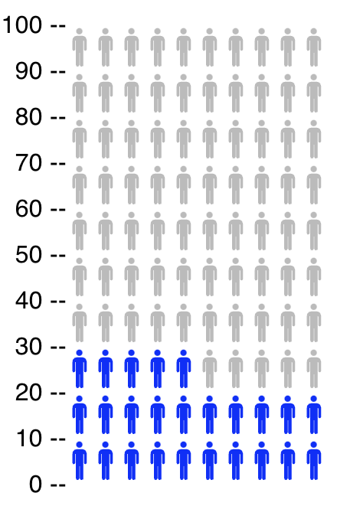
Visualize the data.
A survey asked people, “Have you experienced extreme weather conditions (e.g., hurricane, tornado, flood, or extreme heatwave) in your area in the last year?”
Coastal area residents
# of response | Areas of Residence
 | Coastal | Inland | Mountainous
Yes | 25 | 30 | 15
No | 75 | 20 | 35

Slide 43
Visualize the data.
A survey asked people, “Have you experienced extreme weather conditions (e.g., hurricane, tornado, flood, or extreme heatwave) in your area in the last year?”
Coastal area residents
# of response | Areas of Residence
 | Coastal | Inland | Mountainous
Yes | 25 | 30 | 15
No | 75 | 20 | 35
NO
YES

Slide 44
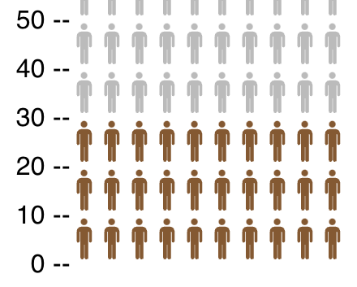
Visualize the data.
A survey asked people, “Have you experienced extreme weather conditions (e.g., hurricane, tornado, flood, or extreme heatwave) in your area in the last year?”
Inland area residents
NO
YES
Response | Areas of Residence
 | Coastal | Inland | Mountainous
Yes | 25 | 30 | 15
No | 75 | 20 | 35

Slide 45
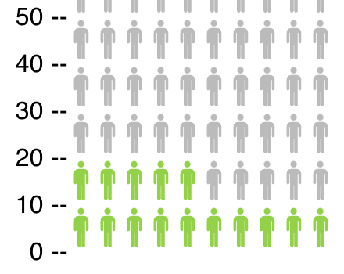
Visualize the data.
A survey asked people, “Have you experienced extreme weather conditions (e.g., hurricane, tornado, flood, or extreme heatwave) in your area in the last year?”
Mountainous area residents
NO
Response | Areas of Residence
 | Coastal | Inland | Mountainous
Yes | 25 | 30 | 15
No | 75 | 20 | 35
YES

Slide 46
Visualize the data.
A survey asked people, “Have you experienced extreme weather conditions (e.g., hurricane, tornado, flood, or extreme heatwave) in your area in the last year?”
Coastal
Inland
Response | Areas of Residence
 | Coastal | Inland | Mountainous
Yes | 25 | 30 | 15
No | 75 | 20 | 35
Mountainous

Slide 47
Which group of students had the highest percentage of “No” responses?
A survey asked people, “Have you experienced extreme weather conditions (e.g., hurricane, tornado, flood, or extreme heatwave) in your area in the last year?”
Response | Areas of Residence
 | Coastal | Inland | Mountainous
Yes | 25 | 30 | 15
No | 75 | 20 | 35

Slide 48
Which group of students had the highest percentage of “No” responses?
A survey asked people, “Have you experienced extreme weather conditions (e.g., hurricane, tornado, flood, or extreme heatwave) in your area in the last year?”
Response | Areas of Residence
 | Coastal | Inland | Mountainous
Yes | 25 | 30 | 15
No | 75 | 20 | 35

Slide 49
Which group of students had the highest percentage of “No” responses?
A survey asked people, “Have you experienced extreme weather conditions (e.g., hurricane, tornado, flood, or extreme heatwave) in your area in the last year?”
Coastal
Inland
Response | Areas of Residence
 | Coastal | Inland | Mountainous
Yes | 25 | 30 | 15
No | 75 | 20 | 35
Mountainous

Slide 50
Which group of students had the highest percentage of “No” responses?
A survey asked people, “Have you experienced extreme weather conditions (e.g., hurricane, tornado, flood, or extreme heatwave) in your area in the last year?”
Coastal
Inland
Response | Areas of Residence
 | Coastal | Inland | Mountainous
Yes | 25 | 30 | 15
No | 75 | 20 | 35
Mountainous

Slide 51
Practice

Slide 52
Group Practice Questions
Please get into a group of 2-3.
Answer the Group Practice questions together.

Slide 53
Group Practice 1

Slide 54
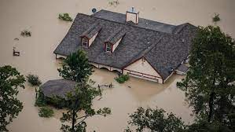
There are several options to reduce household damages from flood. One option would be to elevate the structure of the house above the base flood elevation (BFE). In other words, it is to raise the floor level of the building to be above the level that floodwaters are expected to reach.
54 out of 100 houses that are lower than the BFE have had flood damage, while 39 out of 100 houses that are above the BFE have had flood damages.

Slide 55
There are several options to reduce household damages from flood. One option would be to elevate the structure of the house above the base flood elevation (BFE). In other words, it is to raise the floor level of the building to be above the level that floodwaters are expected to reach.
54 out of 100 houses that are lower than the BFE have had flood damage, while 39 out of 100 houses that are above the BFE have had flood damages.
  To help people understand the data, which type of graph would you choose to visualize the data?
  a. Bar graph
  b. Icon array
  c. The data cannot be visualized.

Slide 56
There are several options to reduce household damages from flood. One option would be to elevate the structure of the house above the base flood elevation (BFE). In other words, it is to raise the floor level of the building to be above the level that floodwaters are expected to reach.
54 out of 100 houses that are lower than the BFE have had flood damage, while 39 out of 100 houses that are above the BFE have had flood damages.
  Visualize the data using the graph type of your choice.
Below BFE: 54 out of 100 houses have flood damage
Above BFE: 39 out of 100 houses have flood damage

Slide 57
There are several options to reduce household damages from flood. One option would be to elevate the structure of the house above the base flood elevation (BFE). In other words, it is to raise the floor level of the building to be above the level that floodwaters are expected to reach.
54 out of 100 houses that are lower than the BFE have had flood damage, while 39 out of 100 houses that are above the BFE have had flood damages.

Slide 58
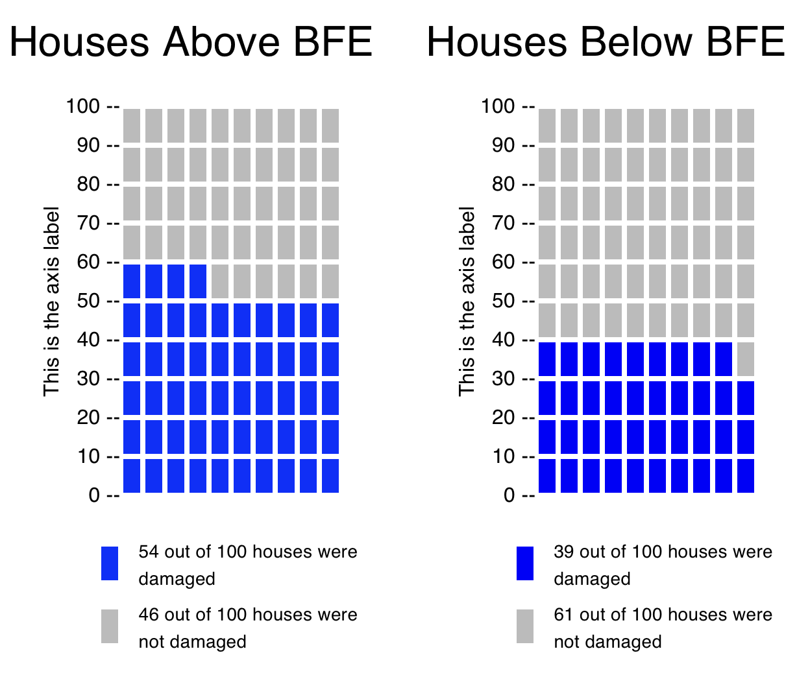
There are several options to reduce household damages from flood. One option would be to elevate the structure of the house above the base flood elevation (BFE). In other words, it is to raise the floor level of the building to be above the level that floodwaters are expected to reach.
54 out of 100 houses that are lower than the BFE have had flood damage, while 39 out of 100 houses that are above the BFE have had flood damages.
  Visualize the data using the graph type of your choice.

Slide 59
There are several options to reduce household damages from flood. One option would be to elevate the structure of the house above the base flood elevation (BFE). In other words, it is to raise the floor level of the building to be above the level that floodwaters are expected to reach.
54 out of 100 houses that are lower than the BFE have had flood damage, while 39 out of 100 houses that are above the BFE have had flood damages.
  Based on the data, the houses above the BFE:
    are more vulnerable to flood damage risk as compared to the houses below the BFE
    are less vulnerable to flood damage risk as compared to the houses below the BFE
    have the same vulnerability to flood damage risk as the houses below the BFE

Slide 60
There are several options to reduce household damages from flood. One option would be to elevate the structure of the house above the base flood elevation (BFE). In other words, it is to raise the floor level of the building to be above the level that floodwaters are expected to reach.
54 out of 100 houses that are lower than the BFE have had flood damage, while 39 out of 100 houses that are above the BFE have had flood damages.
  Based on the data, the houses above the BFE:
    are more vulnerable to flood damage risk as compared to the houses below the BFE
    are less vulnerable to flood damage risk as compared to the houses below the BFE
    have the same vulnerability to flood damage risk as the houses below the BFE

Slide 61
Group Practice 2

Slide 62

Diversity University conducted a survey on the number of incidents of hail damage in student residential buildings for the last 5 years.
The West and East buildings have 50 units each, and the Central building has 100 units.
According to the results, 15 units from the West building, 10 in the East building, and 25 units in the Central building have experienced hail damage.

Slide 63
Diversity University conducted a survey on the number of incidents of hail damage in student residential buildings for the last 5 years.
The West and East buildings have 50 units each, and the Central building has 100 units.
According to the results, 15 units from the West building, 10 in the East building, and 25 units in the Central building have experienced hail damage.
  To help people understand the data, which type of graph would you choose to visualize the data?
  a. Bar graph
  b. Icon array
  c. The data cannot be visualized.

Slide 64
Diversity University conducted a survey on the number of incidents of hail damage in student residential buildings for the last 5 years.
The West and East buildings have 50 units each, and the Central building has 100 units.
According to the results, 15 units from the West building, 10 in the East building, and 25 units in the Central building have experienced hail damage.
Visualize the data using the graph type of your choice.

Slide 65
Diversity University conducted a survey on the number of incidents of hail damage in student residential buildings for the last 5 years.
The West and East buildings have 50 units each, and the Central building has 100 units.
According to the results, 15 units from the West building, 10 in the East building, and 25 units in the Central building have experienced hail damage.
Visualize the data using the graph type of your choice.
West: 15 out of 50
East: 10 out of 50
Central: 25 out of 100

Slide 66
Diversity University conducted a survey on the number of incidents of hail damage in student residential buildings for the last 5 years.
The West and East buildings have 50 units each, and the Central building has 100 units.
According to the results, 15 units from the West building, 10 in the East building, and 25 units in the Central building have experienced hail damage.
Visualize the data using the graph type of your choice.
West: 15 out of 50
East: 10 out of 50
Central: 25 out of 100

Slide 67
Diversity University conducted a survey on the number of incidents of hail damage in student residential buildings for the last 5 years.
The West and East buildings have 50 units each, and the Central building has 100 units.
According to the results, 15 units from the West building, 10 in the East building, and 25 units in the Central building have experienced hail damage.
Visualize the data using the graph type of your choice.
West: 15 out of 50
East: 10 out of 50
Central: 25 out of 100

Slide 68
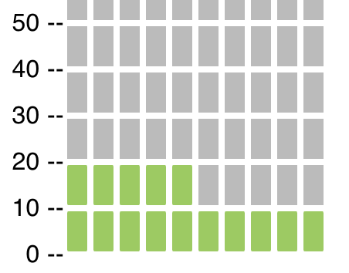
Diversity University conducted a survey on the number of incidents of hail damage in student residential buildings for the last 5 years.
The West and East buildings have 50 units each, and the Central building has 100 units.
According to the results, 15 units from the West building, 10 in the East building, and 25 units in the Central building have experienced hail damage.
Visualize the data using the graph type of your choice.
West: 15 out of 50
East: 10 out of 50
Central: 25 out of 100
West

Slide 69
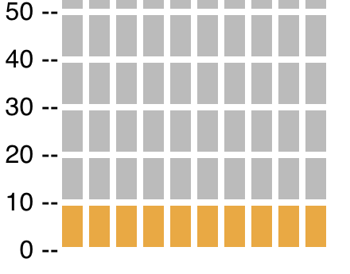
Diversity University conducted a survey on the number of incidents of hail damage in student residential buildings for the last 5 years.
The West and East buildings have 50 units each, and the Central building has 100 units.
According to the results, 15 units from the West building, 10 in the East building, and 25 units in the Central building have experienced hail damage.
Visualize the data using the graph type of your choice.
West: 15 out of 50
East: 10 out of 50
Central: 25 out of 100
West
East

Slide 70
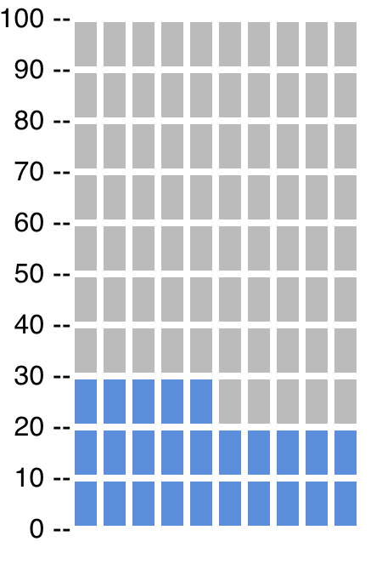
Diversity University conducted a survey on the number of incidents of hail damage in student residential buildings for the last 5 years.
The West and East buildings have 50 units each, and the Central building has 100 units.
According to the results, 15 units from the West building, 10 in the East building, and 25 units in the Central building have experienced hail damage.
Visualize the data using the graph type of your choice.
West: 15 out of 50
East: 10 out of 50
Central: 25 out of 100
West
East
Central

Slide 71
Diversity University conducted a survey on the number of incidents of hail damage in student residential buildings for the last 5 years.
The West and East buildings have 50 units each, and the Central building has 100 units.
According to the results, 15 units from the West building, 10 in the East building, and 25 units in the Central building have experienced hail damage.
Based on the data, which building was most vulnerable to hail damage for the last 5 years?
West
East
Central

Slide 72
Diversity University conducted a survey on the number of incidents of hail damage in student residential buildings for the last 5 years.
The West and East buildings have 50 units each, and the Central building has 100 units.
According to the results, 15 units from the West building, 10 in the East building, and 25 units in the Central building have experienced hail damage.
Based on the data, which building was most vulnerable to hail damage for the last 5 years?
West
East
Central

Slide 73
Individual Practice 1

Slide 74

After an exam you are looking forward to going hiking. You find two trails that you think you would enjoy equally.
Trail A has sunny weather 2 out of 10 days. Trail B has sunny weather 10 out of 100 days.

Slide 75
After an exam you are looking forward to going hiking. You find two trails that you think you would enjoy equally.
Trail A has sunny weather 2 out of 10 days. Trail B has sunny weather 10 out of 100 days.
Based on the data, which trail is more likely to be sunny?
a. Trail A
b. Trail B
c. No difference

Slide 76
After an exam you are looking forward to going hiking. You find two trails that you think you would enjoy equally.
Trail A has sunny weather 2 out of 10 days. Trail B has sunny weather 10 out of 100 days.
Based on the data, which trail is more likely to be sunny?
a. Trail A
b. Trail B
c. No difference

Slide 77
Individual Practice 2

Slide 78

Jimmy and friends are going on a picnic today. They have two destinations in their mind: Town A, and Town B. They checked weather forecasts for the day.
In Town A, there is a 30% chance of rain forecasted for today. In town B, there is a 60% chance of no rain today.

Slide 79
Jimmy and friends are going on a picnic today. They have two destinations in their mind: Town A, and Town B. They checked weather forecasts for the day.
In Town A, there is a 30% chance of rain forecasted for today. In town B, there is a 60% chance of no rain today.
According to the data, to avoid rainy picnic, which would be a better destination for Jimmy?
a. Town A
b. Town B
c. Same probability

Slide 80
Jimmy and friends are going on a picnic today. They have two destinations in their mind: Town A, and Town B. They checked weather forecasts for the day.
In Town A, there is a 30% chance of rain forecasted for today. In town B, there is a 60% chance of no rain today.
According to the data, to avoid rainy picnic, which would be a better destination for Jimmy?
a. Town A
b. Town B
c. Same probability

